Slide 1
Research Computing Update
April 2020

Slide 2
HPC Resources
MI HPC Cluster
Have successfully moved critical HPC services to supported hardware.
Have carried out re-registration process for all HPC users. This was to remove inactive accounts, as well as to collect project and PI information from users.
Initiated purchase process to renew support for h/w which was cancelled at end of 2019.
SAN HPC
Have started procurement process to renew onsite engineer contract, using RC computing funds. This is still outstanding and is becoming urgent now
New HPC Procurement via ANKABUT
Still in process.

Slide 3
Training
“Research Computing intro session”, “Introduction to Linux”, and “Introduction to HPC” courses are all scheduled to be delivered online.
Training calendar is available at https://teamup.com/ksquu2jki56nesnr6n
Due to course being online, places are limited to 5 per session.
All three courses are delivered on a weekly basis.
It is worth noting that 2 months of sessions were scheduled, and all were full within an hour of the advertisement email going out.

Slide 4
Resource Utilization

Slide 5
KU Cluster core distribution

Slide 6
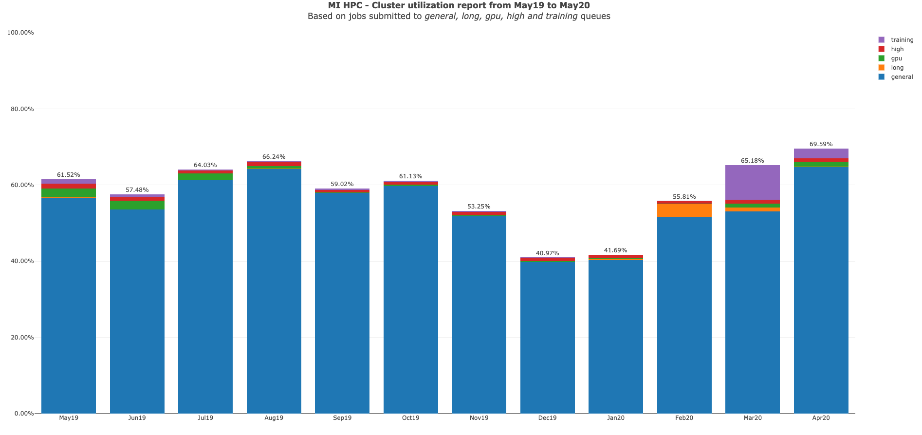

Slide 7
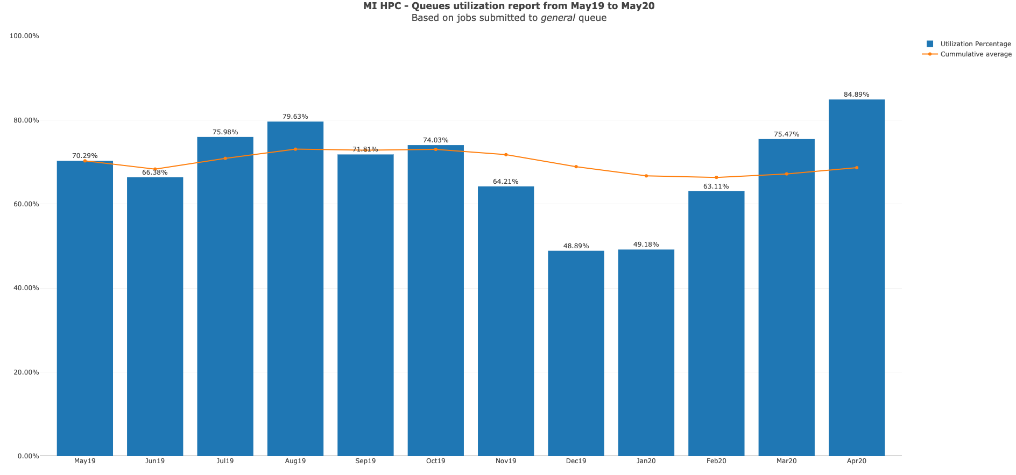

Slide 8
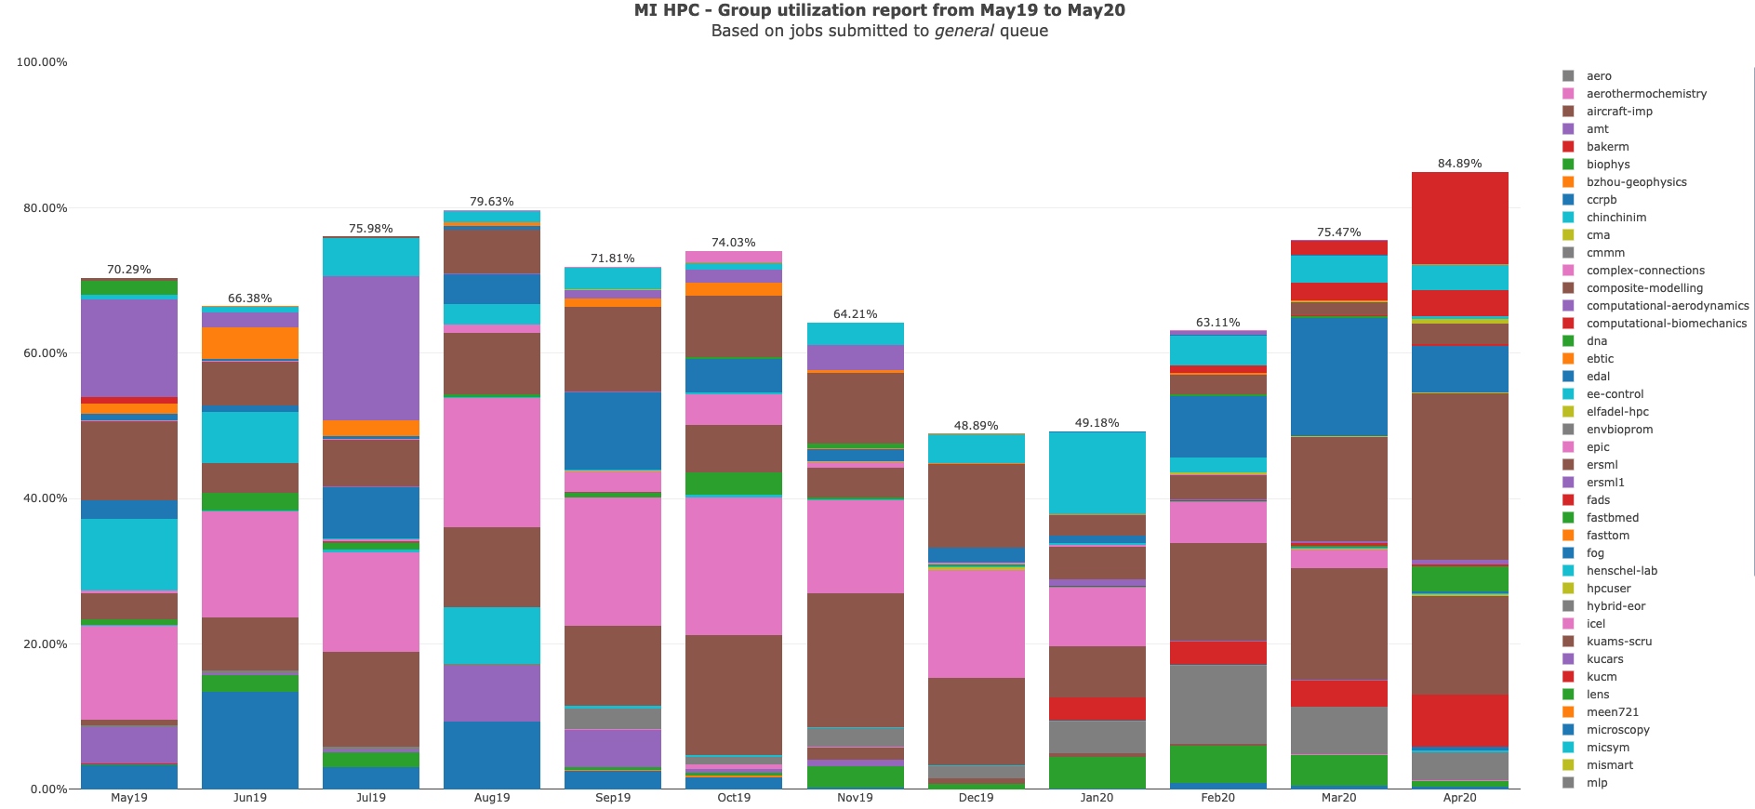

Slide 9
KU HPC Group Utilization for April 2020

Slide 10
PI Cluster core distribution

Slide 11
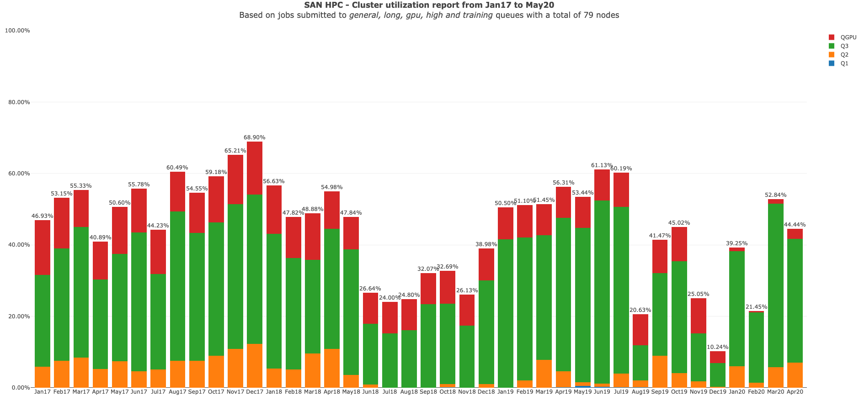

Slide 12
Status of KPI’s

